Slide 1



ICIC Bank Data
Presentation
by Sanket Zade

Slide 2

Problem Statements
1
Employee Search
Retrieve details of an employee with ID 52 working at the ICIC P branch.
2
Location Exclusion
Fetch details of all employees who do not belong to Mumbai, Pune, or Delhi.
3
Account Details
Find the department name, address, branch code, department ID, and city associated with account number 18190.
4
Job Role Filtering
Identify the department ID, department name, and job ID for employees working in Loan, HR, and Admin departments.

Slide 3

Problem Statements (Continued)
5
ATM Number Lookup
Determine the account type and state for the account associated with ATM number 422748663.
6
View Creation: Employee Details
Create a view displaying address, branch name, department name, first name, and phone number.
7
View Creation: City and Department
Create a view showing city and department name for accounts opened before May 24, 2004.
8
View Creation: Employee Job Details
Create a view named "employee_job_details" containing all details of employees with job roles as Clerk, Manager, or Accountant.

Slide 4

Problem Statements (Continued)
9
ATM Number Update
Modify the ATM number in the Customer table, changing 423295535 to 42321992.
10
Account Type Update
Update the Account\_type table, changing all "sales" accounts to "admin".

Slide 5

Data Tables
Account\_type
Department
Bank\_Details
Job\_Details
Employee
Customer
These tables form the core of the ICIC Bank Data Management System, each containing specific information related to banking operations, employee details, customer information, and other relevant data.

Slide 6
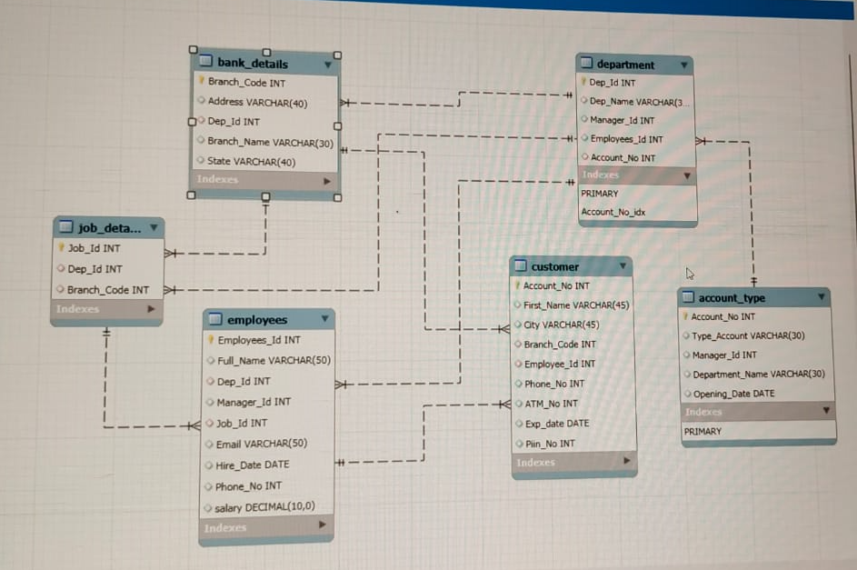
Table Relationships
The tables are interconnected through foreign keys, ensuring data integrity and consistency. For instance, the Account\_type table relates to the Department table via the Account\_no field, while the Department table connects to Bank\_Details and Employees through Department\_id and Employee\_id, respectively. Similarly, the Customer table links to Bank\_Details and Employees using Branch\_code and Employee\_id.

Slide 7

Benefits of Data Management System
Improved Data Management
The system facilitates efficient data organization, storage, and retrieval, enabling streamlined access to critical information.
Risk and Fraud Detection
By analyzing data patterns, the system can identify potential risks and fraudulent activities, enhancing security and mitigating losses.
Actionable Customer Insights
The system provides valuable insights into customer behavior, preferences, and needs, enabling targeted marketing and personalized services.
Data Security
The system incorporates robust security measures to protect sensitive data from unauthorized access, ensuring data confidentiality and integrity.

Slide 8

Future Applications
1
Expansion
The system can be expanded to support operations in different states, facilitating seamless data management across a wider geographical area.
2
Personalized Offers
The system can be used to generate personalized offers for customers based on their spending habits and preferences, enhancing customer satisfaction and loyalty.
3
AI-Powered Solutions
The system can be integrated with AI models to provide automated customer support, predict customer needs, and optimize banking operations.

Slide 9
THANK YOU
© All rights reserved by Fireblaze Technologies Pvt. Ltd.

